Slide 1
Feeder Emphasis (High Vessel Recruitment)
t
e
x
t

Slide 2
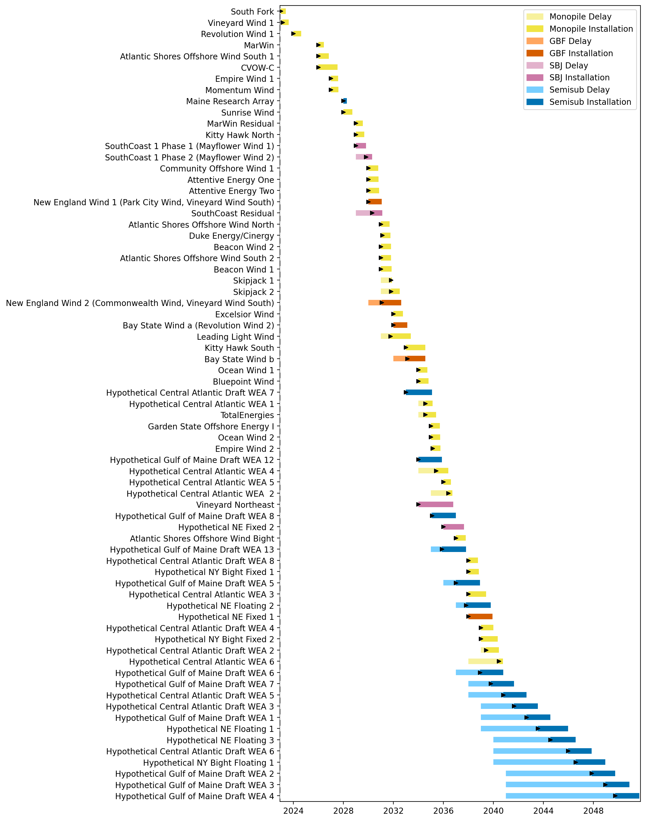
Full Gantt

Slide 3
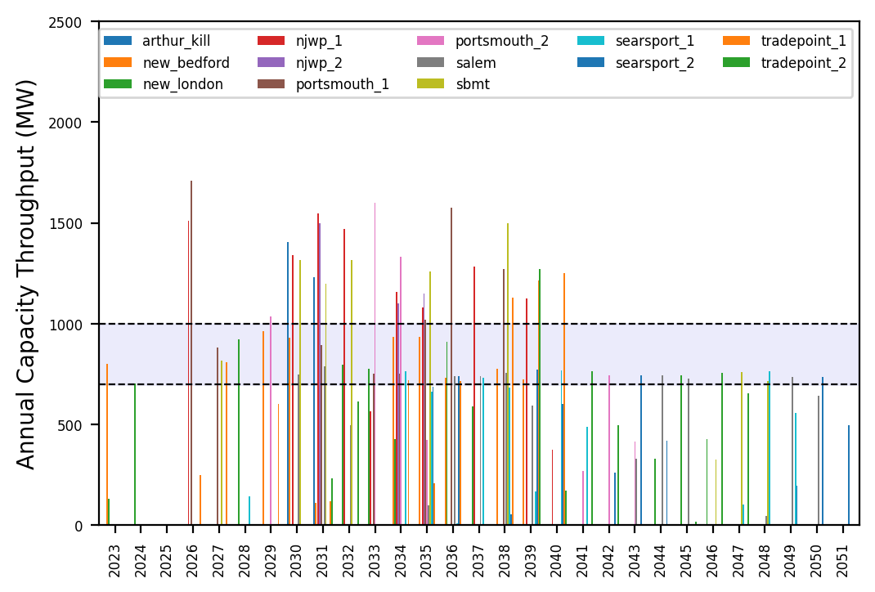
Port Throughput

Slide 4
Feeder Emphasis (Low Vessel Recruitment)
t
e
x
t

Slide 5
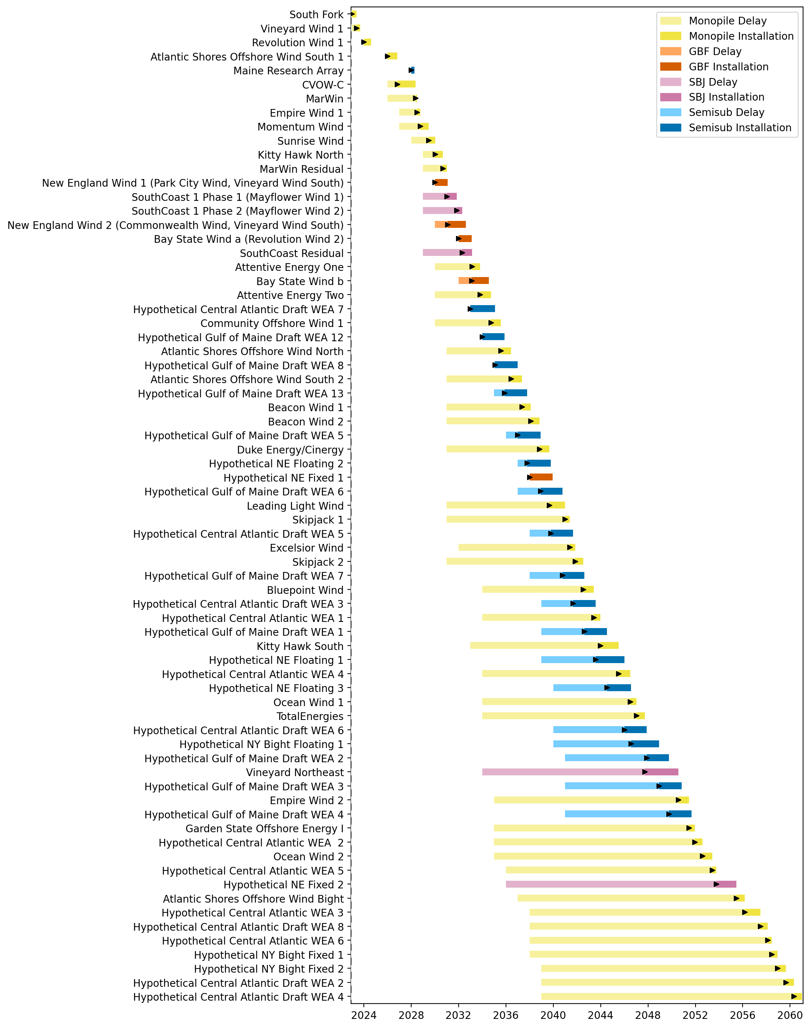
Full Gantt

Slide 6
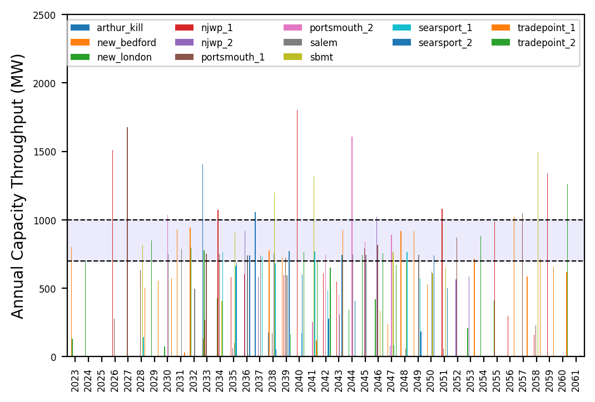
Port Throughput

Slide 7
Hybrid
t
e
x
t

Slide 8
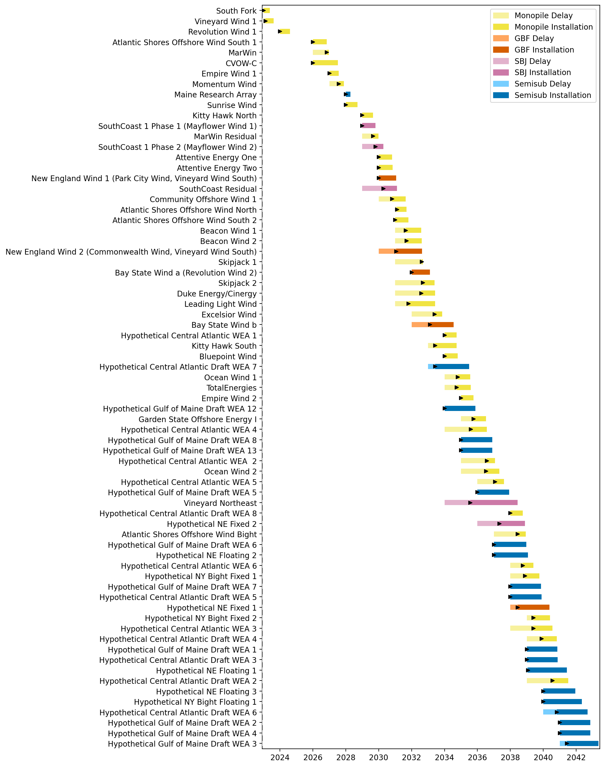
Full Gantt

Slide 9
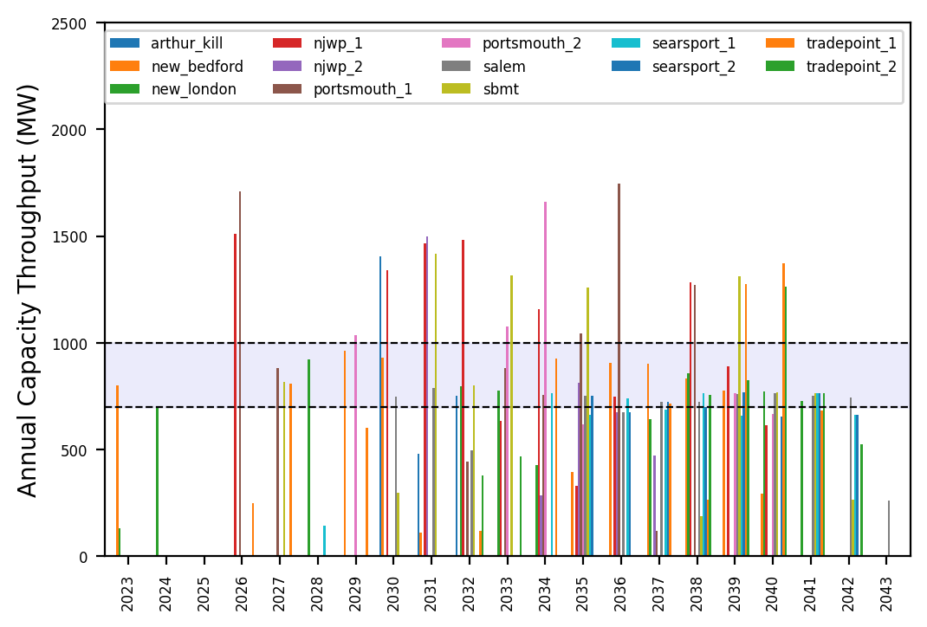
Port Throughput

Slide 10
No Action
t
e
x
t

Slide 11
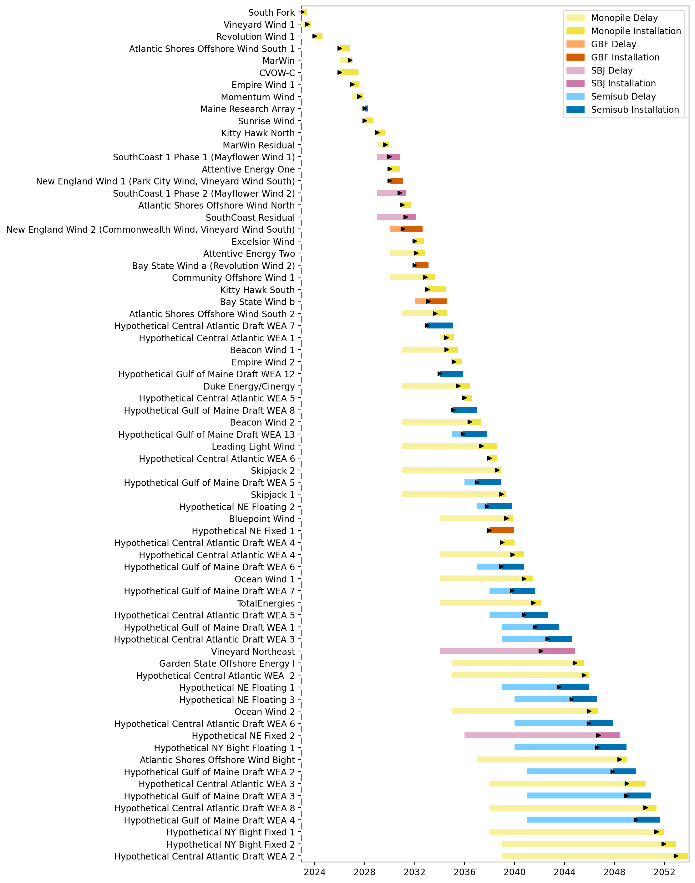
Full Gantt

Slide 12
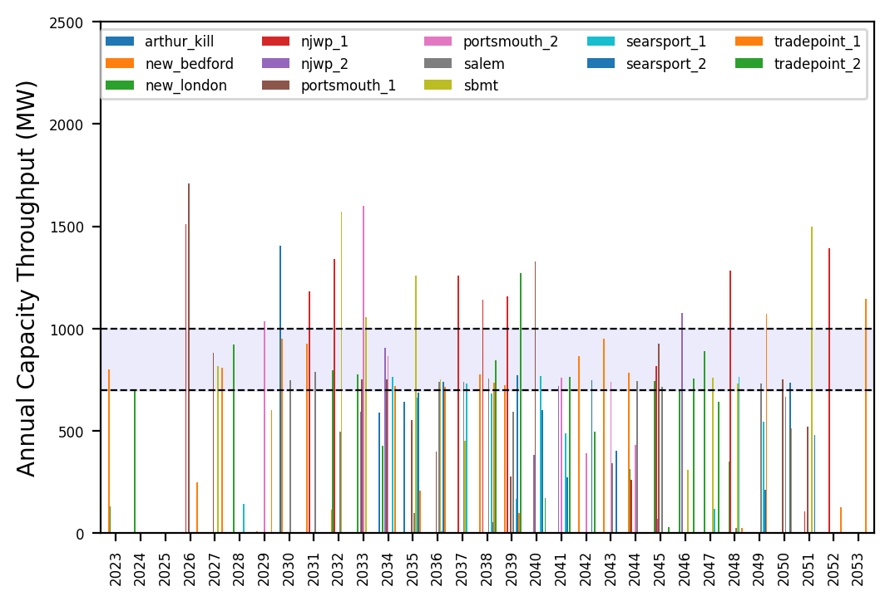
Port Throughput

Slide 13
Infinite Vessels
t
e
x
t

Slide 14
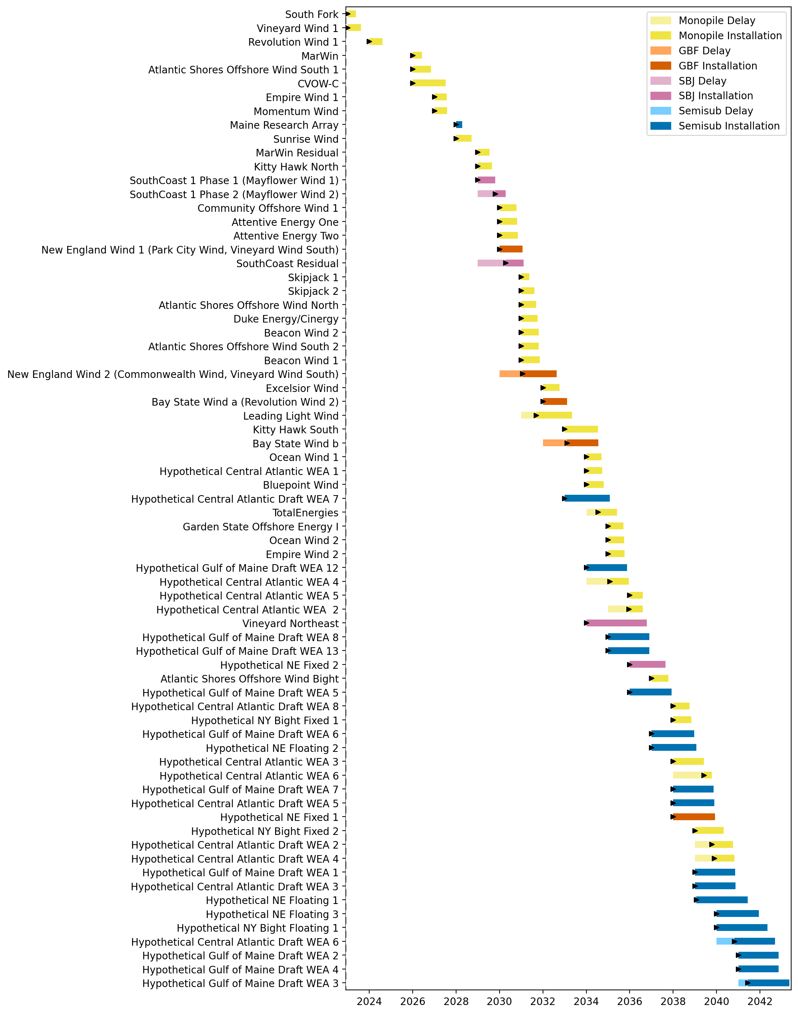
Full Gantt

Slide 15
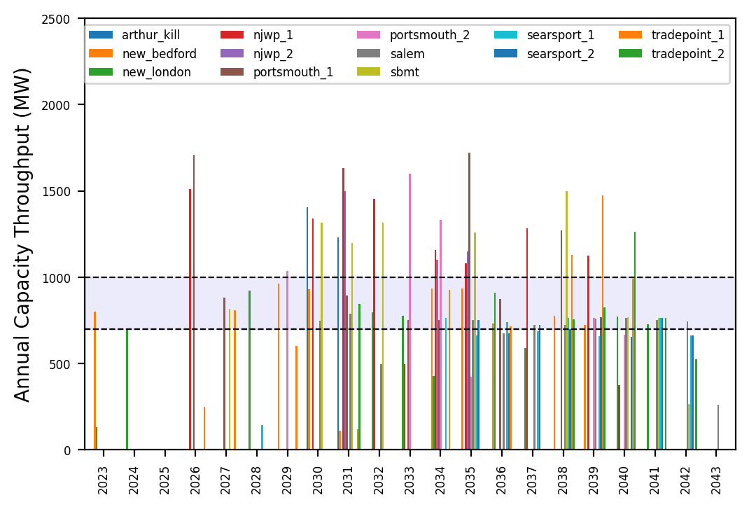
Port Throughput

Slide 16
WTIV Emphasis
t
e
x
t

Slide 17
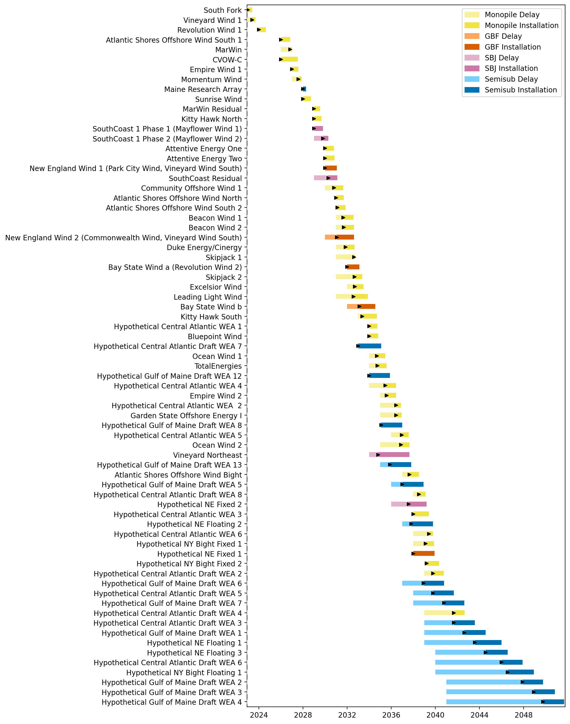
Full Gantt

Slide 18
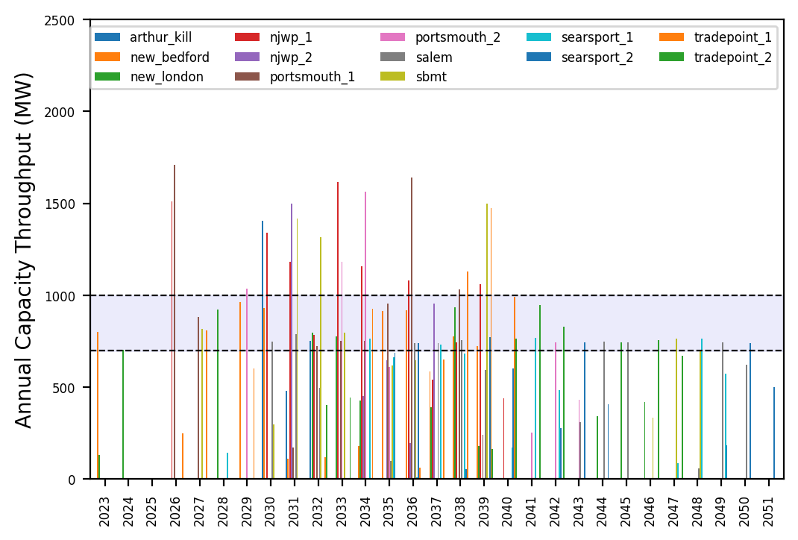
Port Throughput

Slide 19
AHTS Emphasis
t
e
x
t

Slide 20
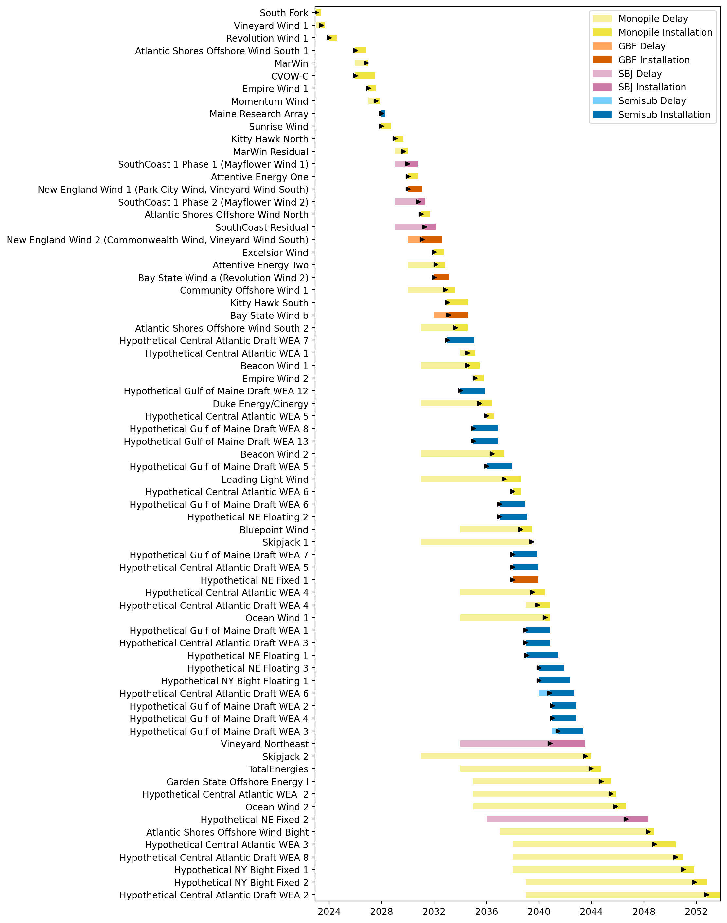
Full Gantt

Slide 21
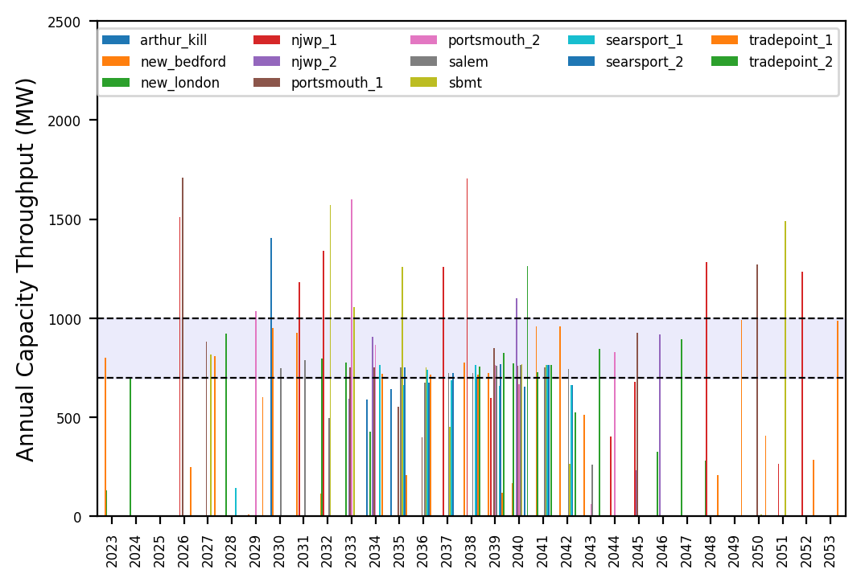
Port Throughput

Slide 22
Hybrid (Low Vessel Recruitment)
t
e
x
t

Slide 23
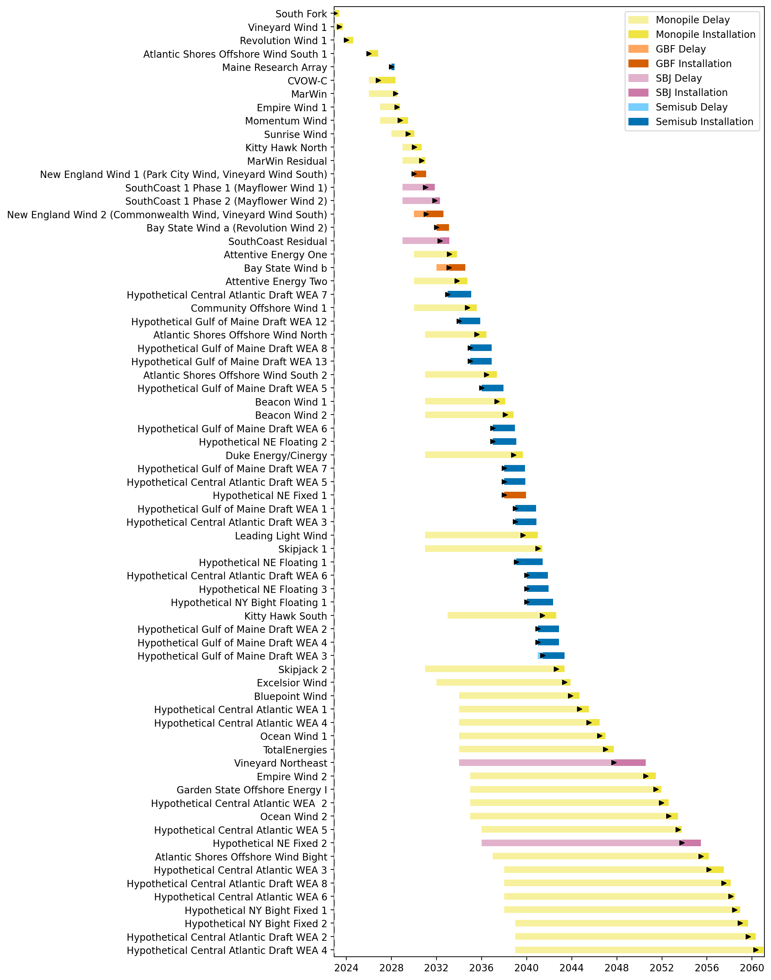
Full Gantt

Slide 24
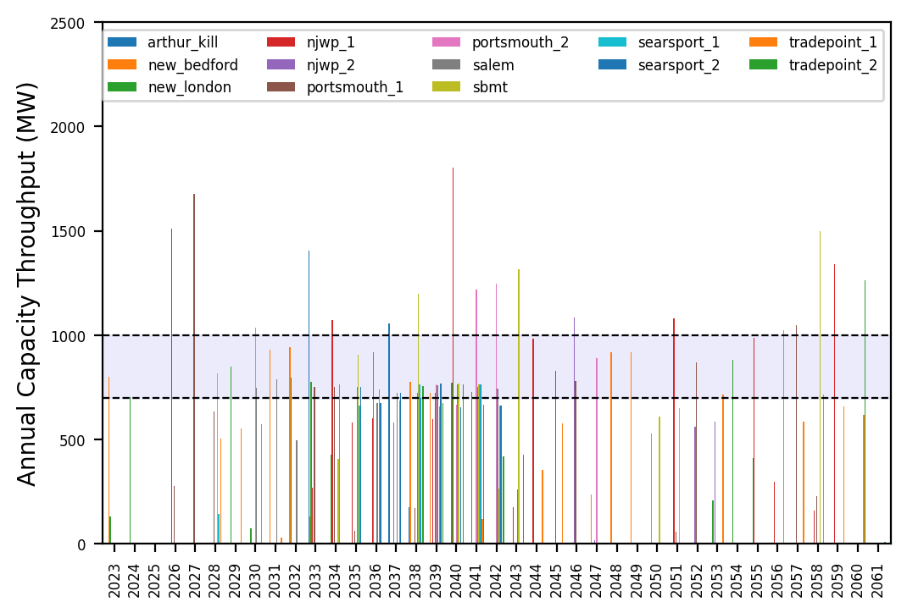
Port Throughput

Slide 25
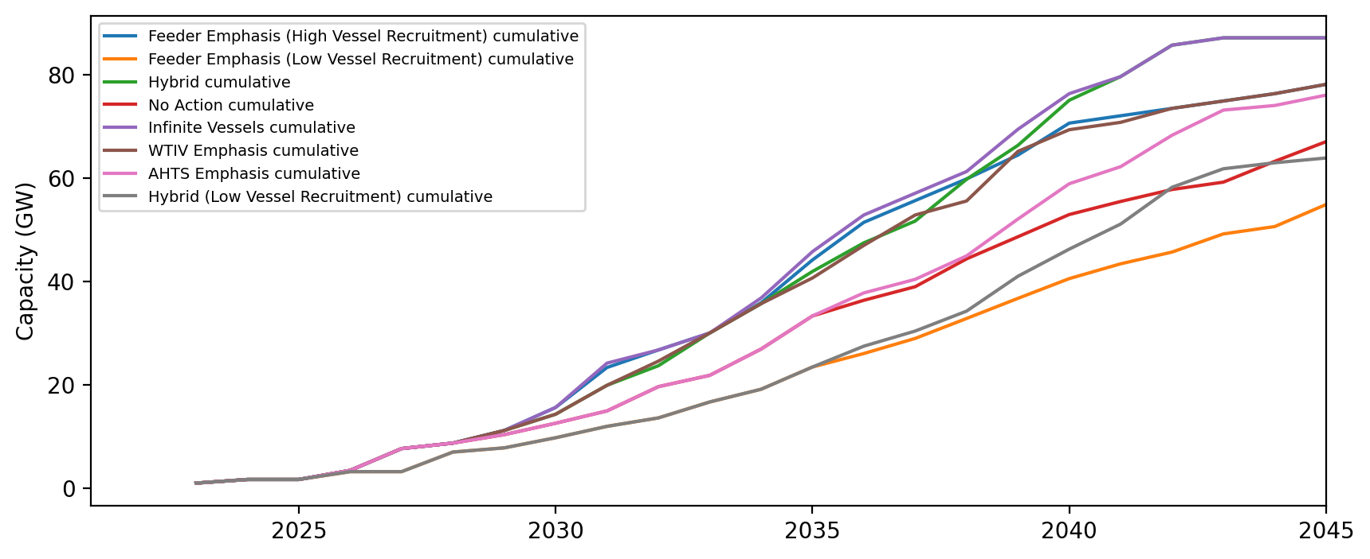
Installed Capacity

Slide 26
Installed Capacity - All Regions

Slide 27
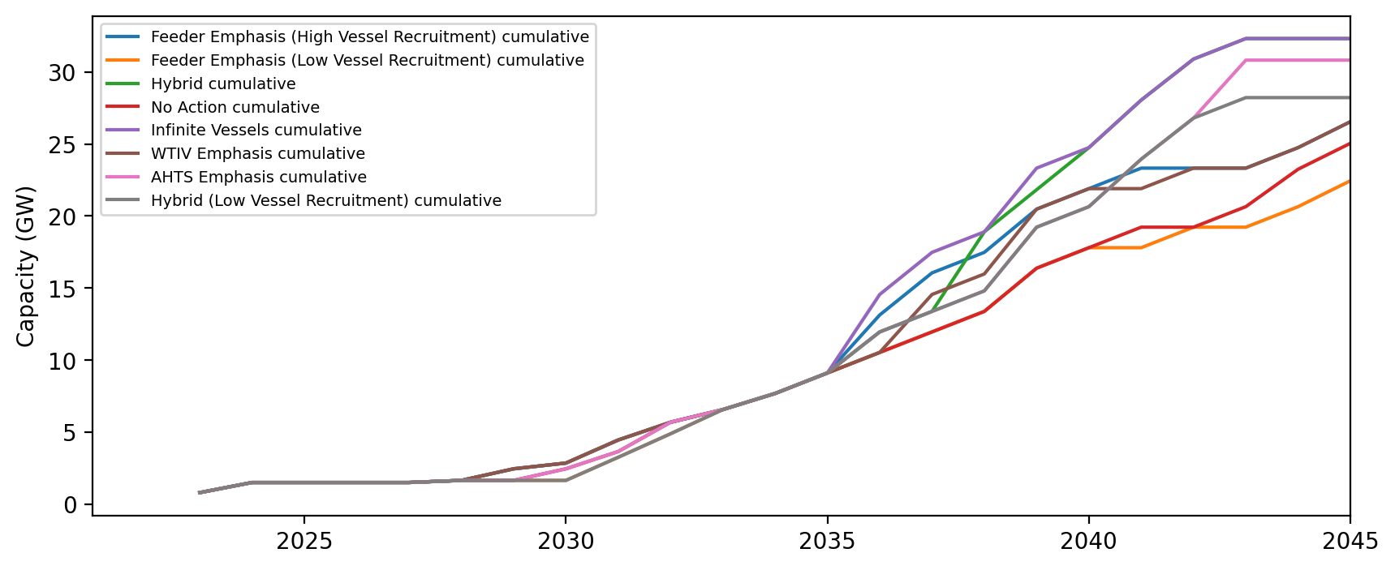
Installed Capacity - NE

Slide 28
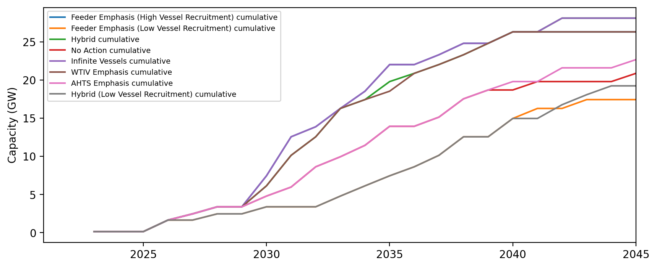
Installed Capacity - NYNJ

Slide 29
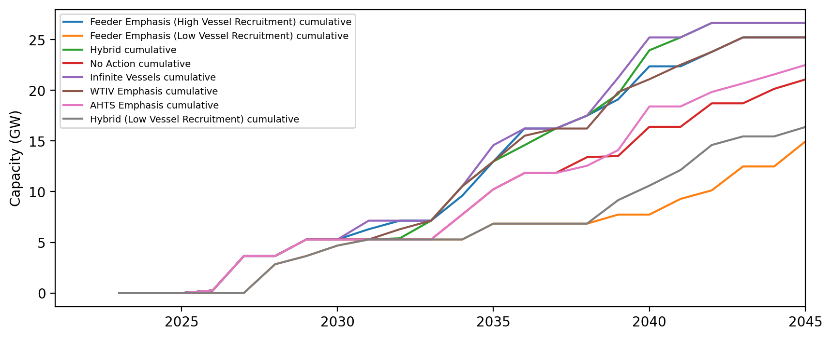
Installed Capacity - Mid-Atlantic

Slide 30
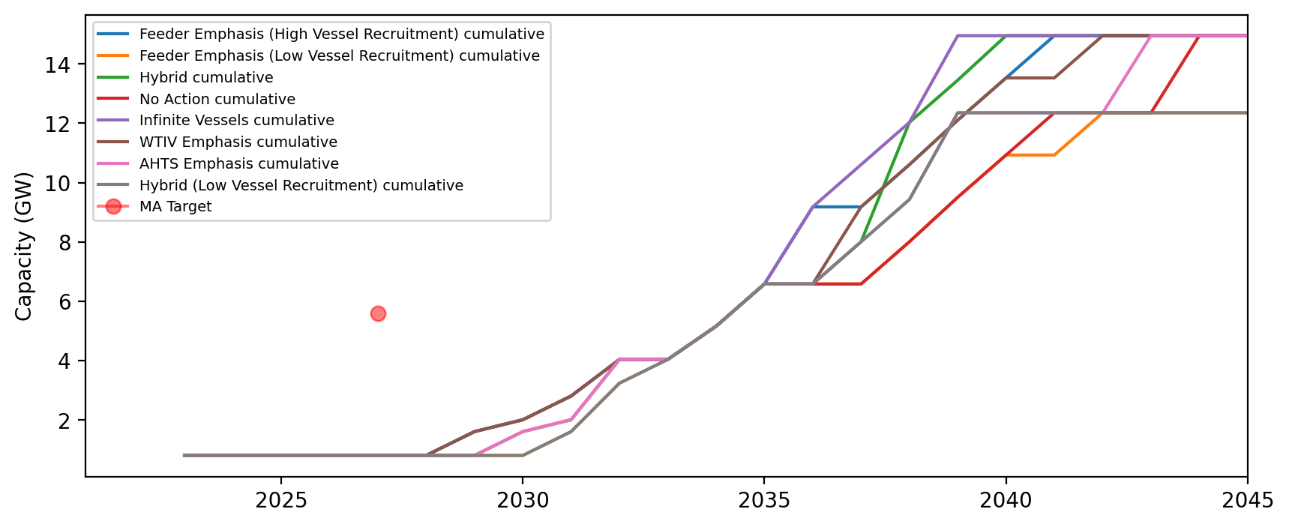
Installed Capacity - MA

Slide 31
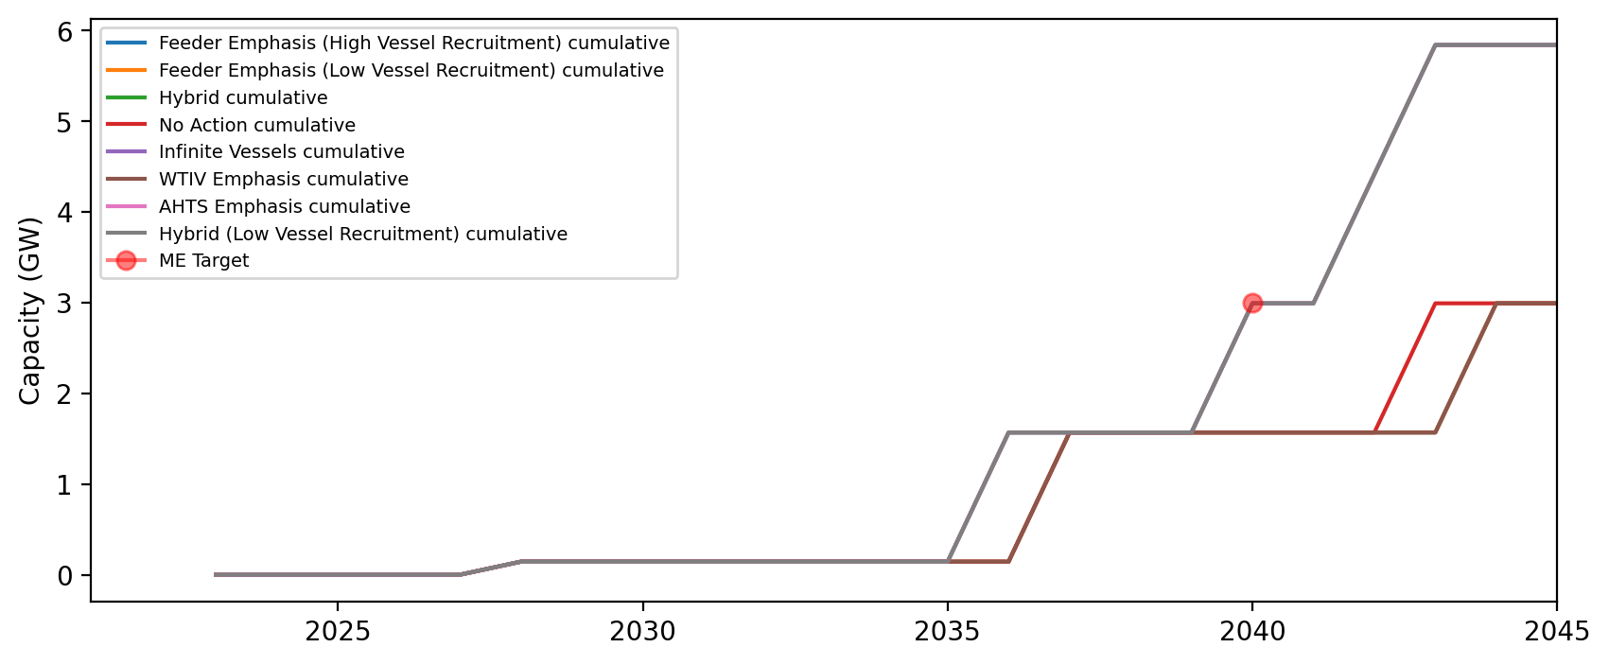
Installed Capacity - ME

Slide 32
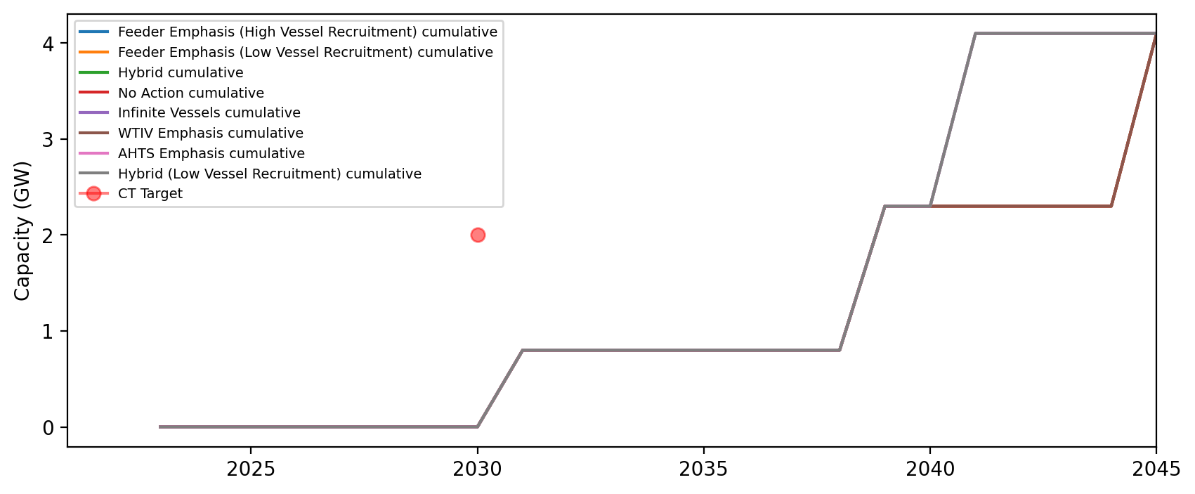
Installed Capacity - CT

Slide 33
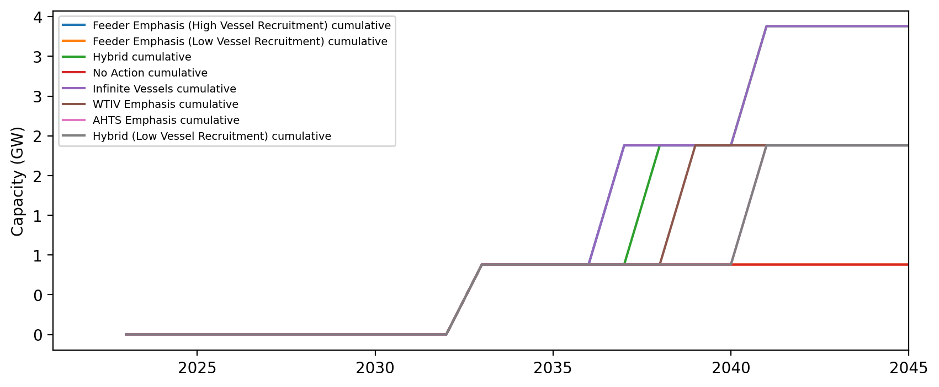
Installed Capacity - RI

Slide 34
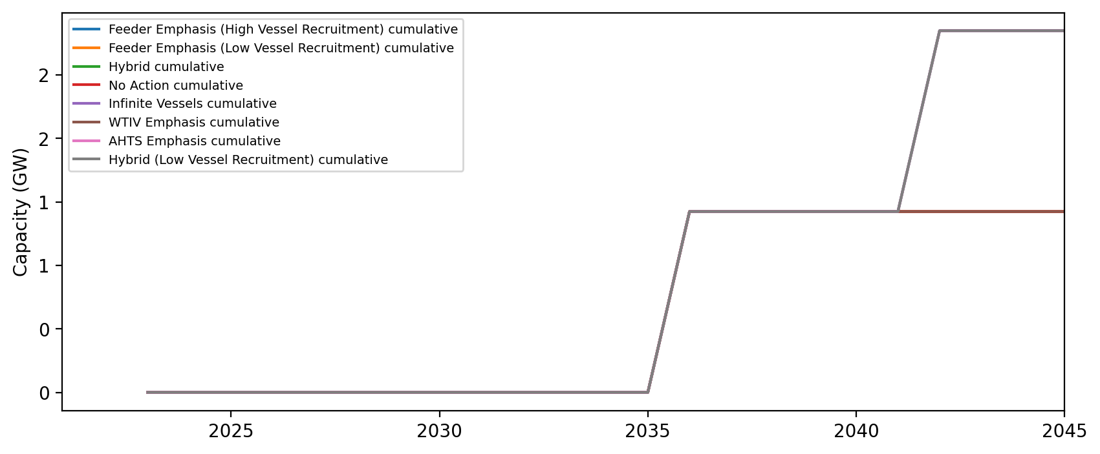
Installed Capacity - NH

Slide 35
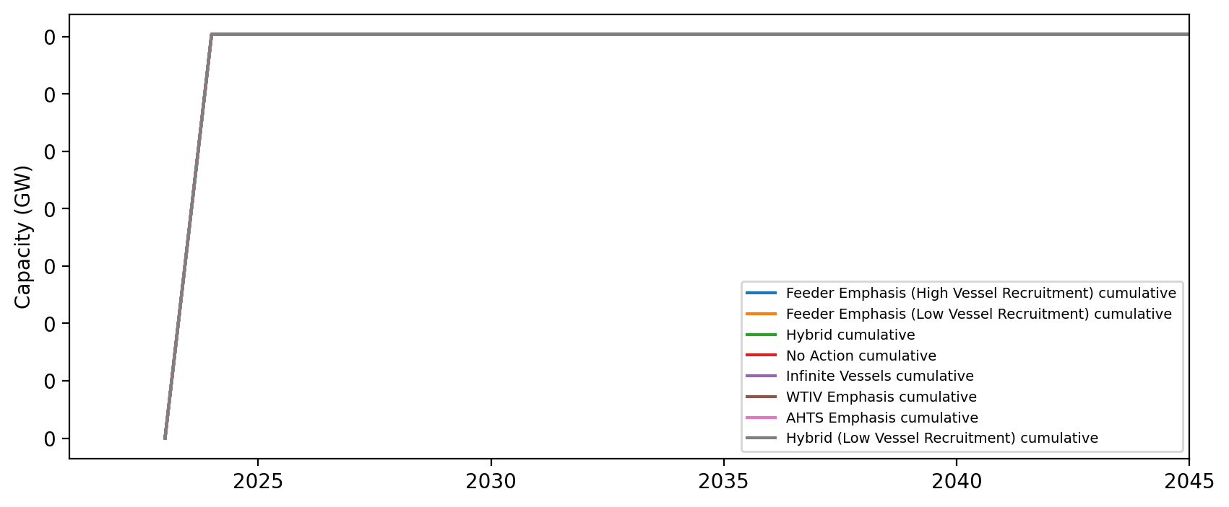
Installed Capacity - RI/CT

Slide 36
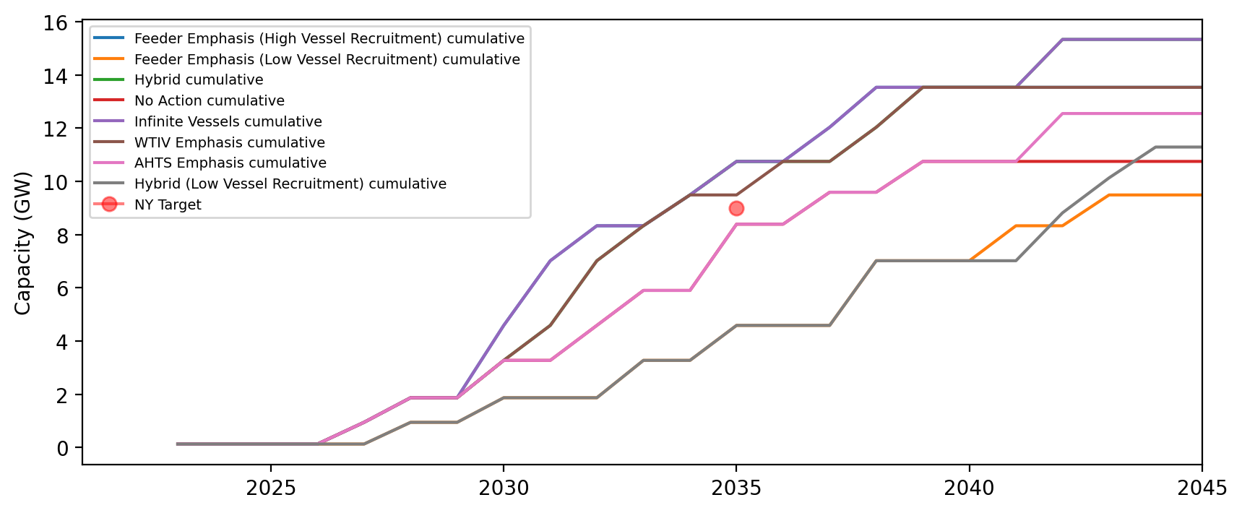
Installed Capacity - NY

Slide 37
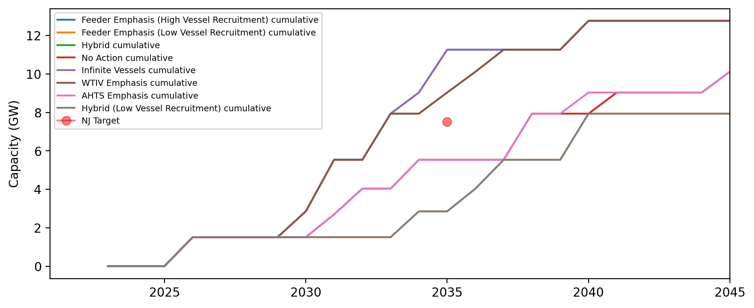
Installed Capacity - NJ

Slide 38
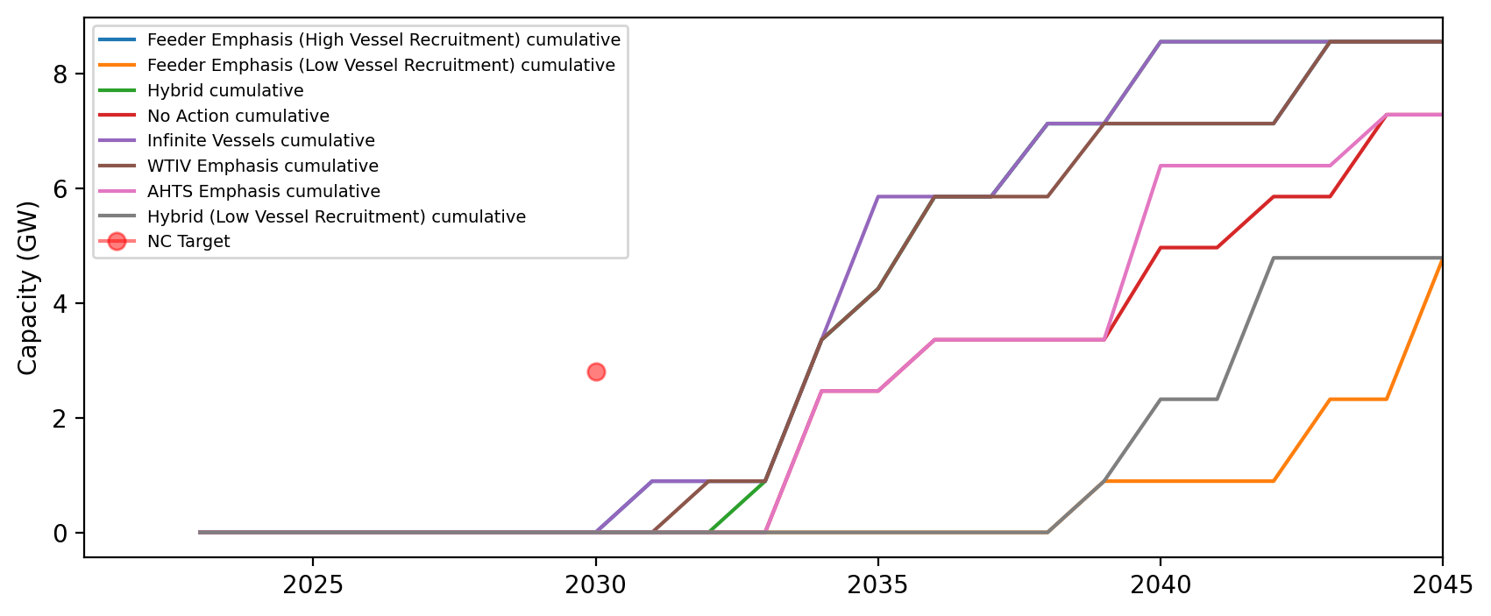
Installed Capacity - NC

Slide 39
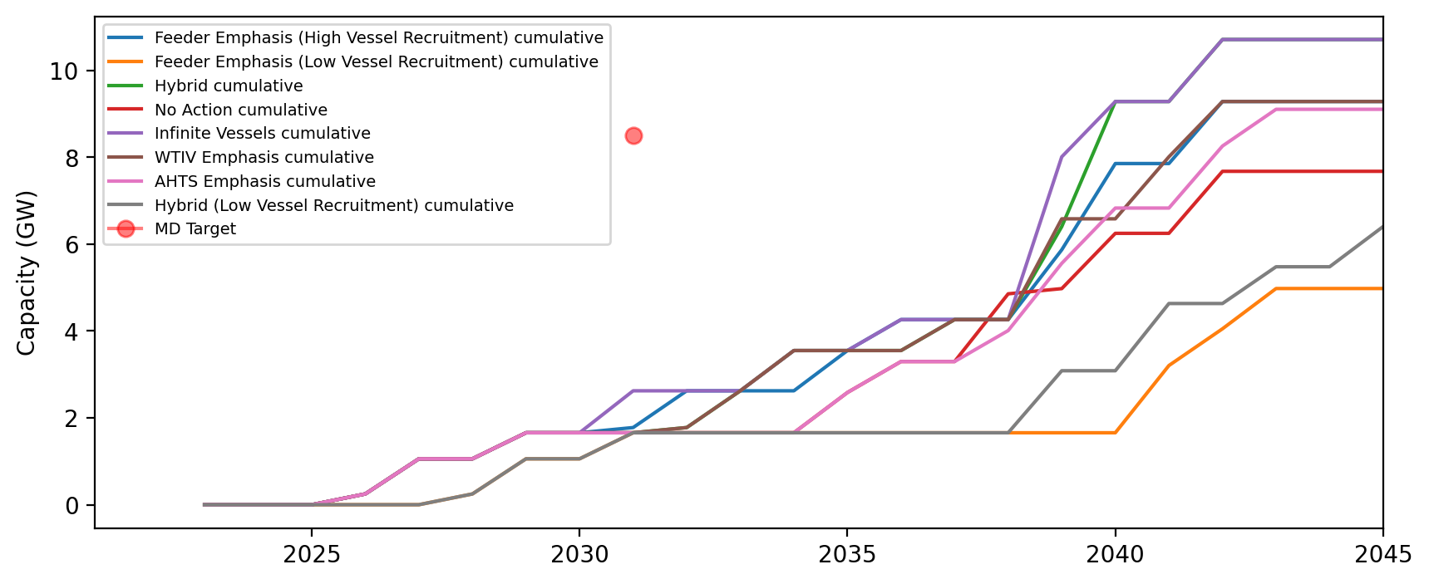
Installed Capacity - MD

Slide 40
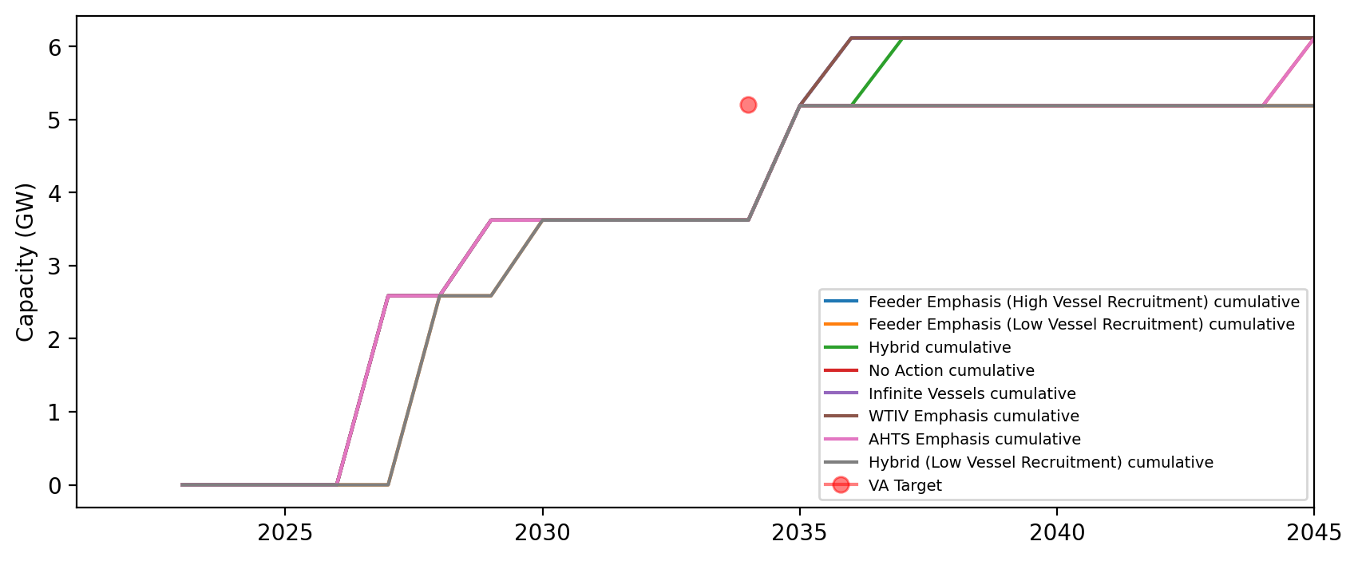
Installed Capacity - VA

Slide 41
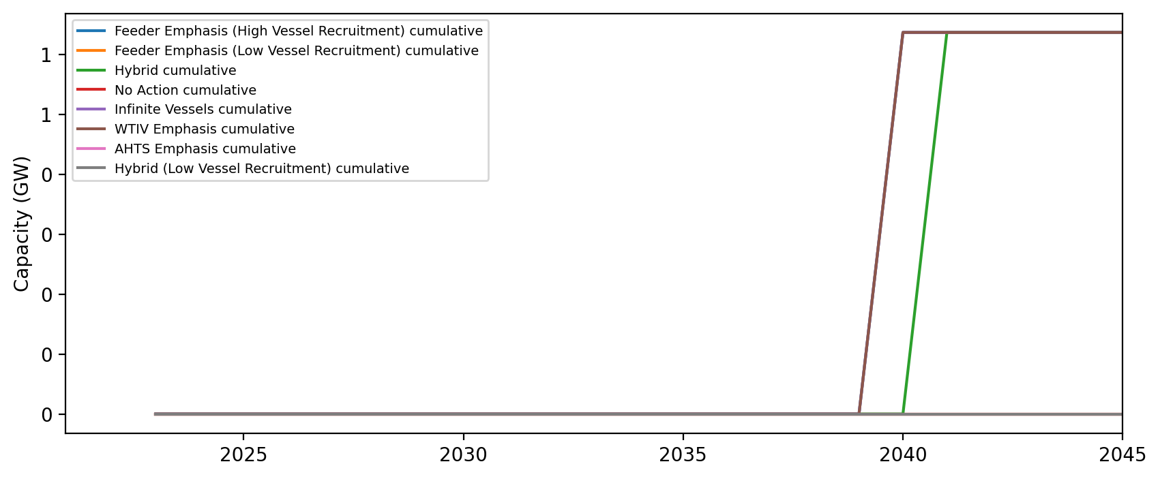
Installed Capacity - DE

